Slide 1
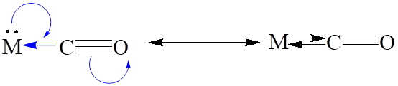
Infrared (IR) Spectroscopy and C=O Bond Strength
IR spectra provides information about the stretching frequency of a bond. Recall that the stronger a bond gets, the higher its stretching frequency.
The υ_{CO} stretching frequency of the coordinated CO is very informative as to the nature of the bonding.
Thus, the more important the M=C=O (C=O is a double bond) canonical structure, the lower the υ_{CO} stretching frequency as compared to the M-C≡O structure (C≡O is a triple bond): (Note: υ_{CO} for free CO is 2141 cm⁻¹)
[Ti(CO)₆]²⁻ [V(CO)₆]⁻ [Cr(CO)₆] [Mn(CO)₆]⁺ [Fe(CO)₆]²⁺
υ_{CO} 1748 1858 1984 2094 2204 cm⁻¹
increasing M=C double
bonding
decreasing M=C double
bonding

Slide 2
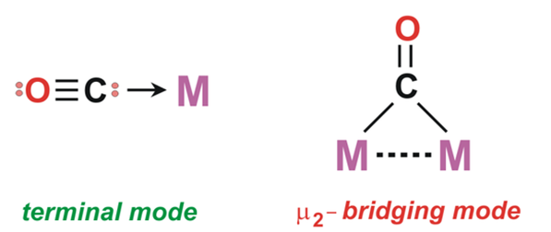
IR Spectra: Bridging vs Terminal Carbonyls
Bridging CO groups can be regarded as having a double bond C=O group, as compared to a terminal C≡O, which is more like a triple bond:
M
M-C≡O C=O
M
One can thus use the CO stretching
frequencies around 1700-2200 cm⁻¹ to
detect the presence of bridging CO groups.
the C=O group
in a bridging
carbonyl is more
like the C=O in
a ketone, which
typically has
υ_{C=O} = 1750 cm⁻¹
~ triple bond
~ double bond
terminal carbonyl bridging carbonyl
(~ 1850-2125 cm⁻¹) (~1700-1860 cm⁻¹)

Slide 3
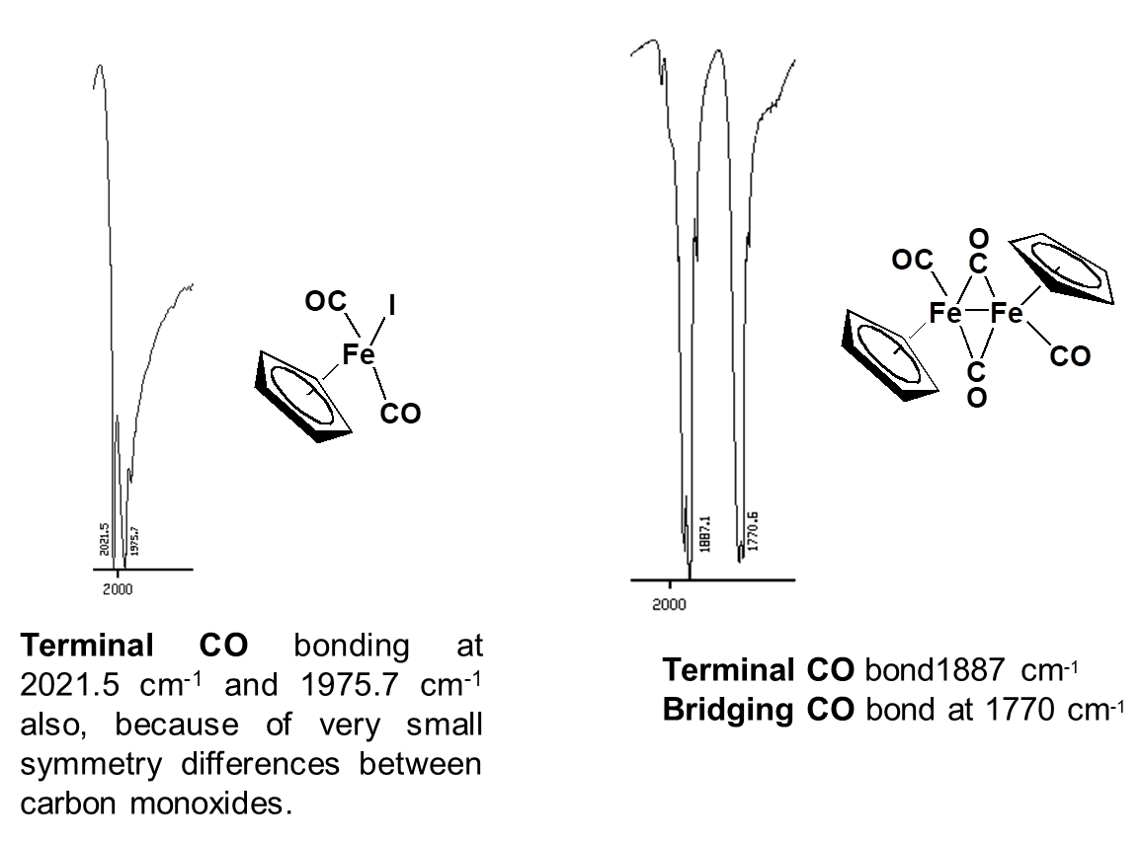
Bridging vs Terminal CO

Slide 4
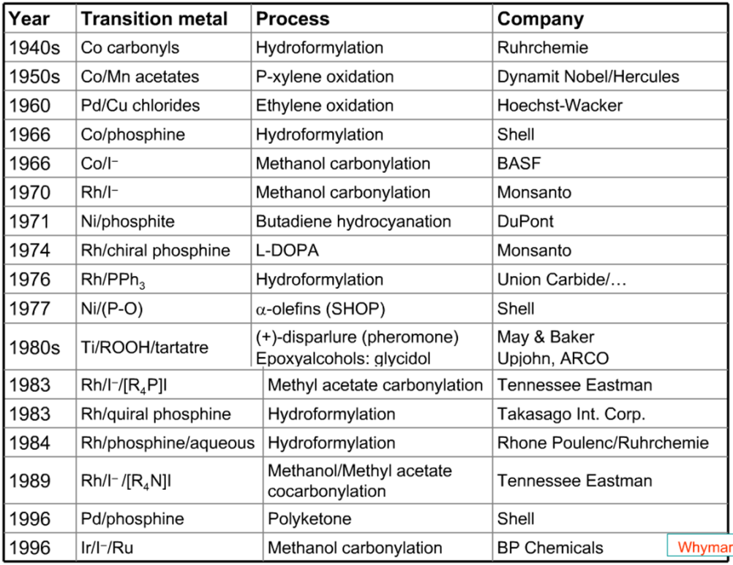
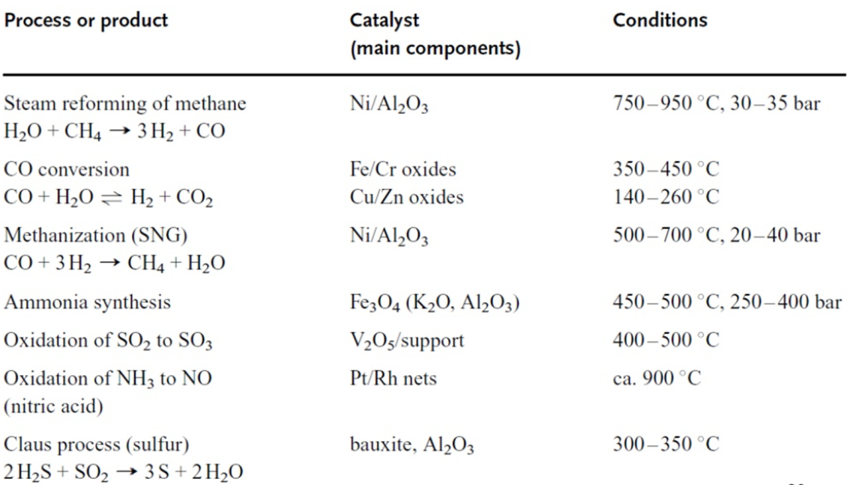
Reactions of Organometallic Compounds
Organometallic compounds are involved in a many industrially important chemical processes.
Mechanistic understanding of reactivity can be made easy by considering some common steps in isolation. E.g. Oxidative Addition, Reductive Elimination, Migratory Insertion and Elimination.
Some important industrial chemical processes.

Slide 5

Oxidative Addition
A reaction in which (usually) a neutral ligand adds to a metal center and in doing so oxidizes the metal, typically by 2e-.
The transferring of the two electrons from the metal to the incoming ligand breaks a bond in that ligand forming two new anionic ligands. Atleast one of these new anionic ligands ends up bonded to the metal center.
The new M-X and M-Y bonds are formed using:
the electron pair of the X-Y bond
one metal-centered lone pair
The metal goes up in oxidation state (+2)
X-Y formally gets reduced to X⁻, Y⁻

Slide 6
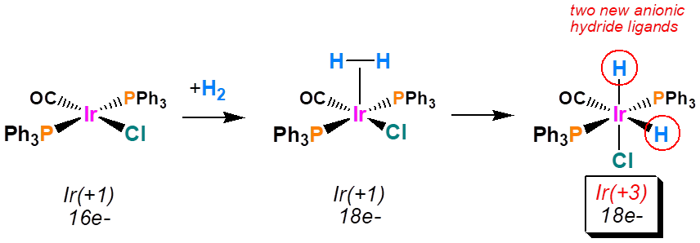
Types of Substrates (X-Y)
Depending on the nature of the substrate (X-Y), the mechanism of the oxidative addition may differ .
There are three main classes of molecules (substrates) that can perform oxidative additions to metal centers:
Non-Electrophillic; Non-Electrophillic “Intact”; Electrophillic
Non-electrophillic: These molecules do NOT contain electronegative atoms and/or are not good oxidizing agents. These molecules usually require the presence of an empty orbital on the metal in order for them to pre-coordinate prior to being activated for the oxidative addition rxn.

Slide 7
Non Electrophilic Substrates that Do Not Fragment
Non-electrophillic “Intact”: These molecules have a double or triple bond present. One also needs a metal center with an empty orbital (16e- or lower count) in order to pre-coordinate the ligand before the oxidative addition occurs.
Alkenes and alkynes are typical “intact” ligands that can perform an oxidative addition without fragmenting apart.

Slide 8
Electrophilic Substrates
Electrophillic: These molecules do contain electro­negative atoms and are good oxidizing agents. They are often considered to be “reactive” substrates.
These molecules do NOT require the presence of an empty orbital (18e- is OK) on the metal center in order to perform the oxidative addition rxn. Examples: X₂ (X = Cl, Br, I), R-X, Ar-X, H-X, O₂, etc.

Slide 9
Oxidative Addition: Electrophilic Substrates
In the case of a starting 18e- complex (shown below) only one of the two anionic ligands (usually the strongest binding) generated from the oxidative addition will end up coordinated to the metal unless a separate substitution reaction occurs.

Slide 10
Reductive Elimination
A reductive elimination reaction is the reverse of an oxidative addition. It is a reaction in which two cisoidal anionic ligands on a metal center couple together. Each anionic ligand pushes one electron back onto the metal center (in the case of a monometallic complex) to reduce it by 2e-. The coupled anionic ligands then usually fall off the metal center as a neutral molecule.

Slide 11
Reductive Elimination: Effect of Ligand Dissociation
Sometimes, more than one reductive elimination possibilities arise from saturated 18e- complexes (so long as the two ligands that you want to reductively eliminate are cisoidal to one another).
An understanding of the electronic requirements can facilitate reaction engineering to favour one option over the other.
Both pathways occurred; reaction was slow (~ many hours)

Slide 12
Reductive Elimination: Effect of Ligand Dissociation
It has been shown that reductive elimination can be promoted by a ligand dissociation generating an unsaturated and more electron-deficient metal center.

Slide 13
Migratory Insertion
A migratory insertion reaction is when a cisoidal anionic and neutral ligand on a metal complex couple together to generate a new coordinated anionic ligand. This new anionic ligand is composed of the original neutral and anionic ligands now bonded to one another.
There is NO change in the oxidation state or d electron-count of the metal center.

Slide 14
Migratory Insertion: Who Migrates to Whom?

Slide 15
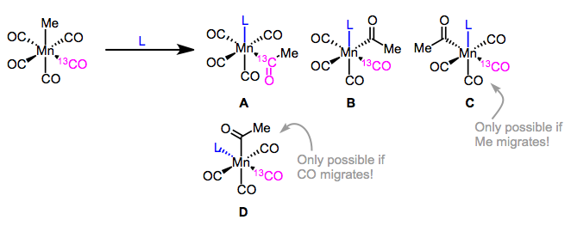
Who Migrates to Whom? Experiment Design
Four products of insertion are possible, corresponding to reaction of the four CO ligands cis to the methyl ligand. Consider both CO migration and Me migration as possible at this point.
Product D is impossible if we only allow the Me group to migrate—the spot trans to the labelled CO is another CO ligand, so that spot can only pick up L if CO migrates (not if Me migrates).
On the other hand, product C must have come from the migration of Me, since the Me group has moved from a cis to a transposition relative to the labeled CO in product C.
Products A, B, and C were observed, but not D, supporting a mechanism involving Me migration. Other experiments since support the idea that most of the time, the alkyl group migrates onto CO.

Slide 16
Migratory Insertion of Alkenes
Successive migratory insertions can lead to chain elongation

Slide 17
Eliminations
The most common elimination is β-hydride elimination. It can be thought of as the opposite of migratory insertion.
No change in formal oxidation state
You must have an empty orbital that is cisoidal to the group that you are doing an elimination reaction on. Alternatively, a cisoidal labile ligand that can easily dissociate to open up an empty orbital.

Slide 18
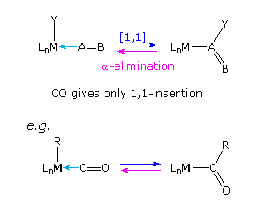
Other Eliminations
α-hydride elimination.
Carbonyl elimination or decarbonylation.
No change in formal oxidation state
You must have an empty orbital that is cisoidal to the group that you are doing an elimination reaction on. Alternatively, a cisoidal labile ligand that can easily dissociate to open up an empty orbital.

Slide 19
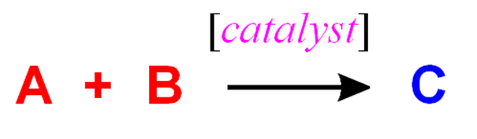
Catalytic Applications of Organometallic Complexes
1850 Berzelius
1895 Ostwald: a catalyst is a substance
that changes the rate of a chemical reaction
without itself appearing into the products.
A catalyst
Speeds up a reaction
Enables a reaction to proceed that otherwise does not without it
Typically added in non-stoichiometric amounts
Remains unchanged at the end of the reaction
Catalysis is a kinetic phenomenon.

Slide 20
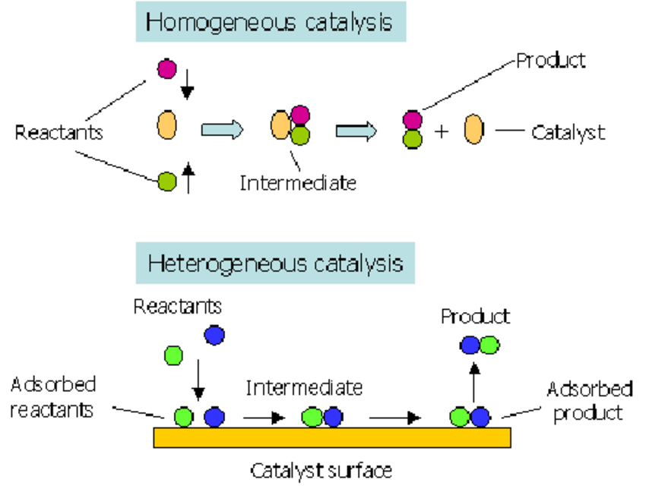
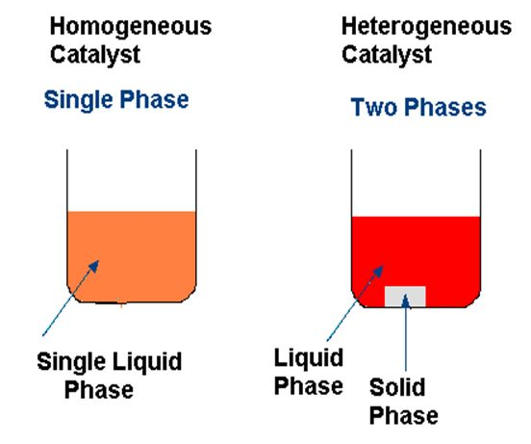
Homogeneous And Heterogeneous Catalysis
Homogeneous catalysis: Catalyst and reactants are in the same phase.
Heterogeneous catalysis: Catalyst and reactants are in the different phase (the catalyst is usually insoluble; reaction occurs on its surface).

Slide 21
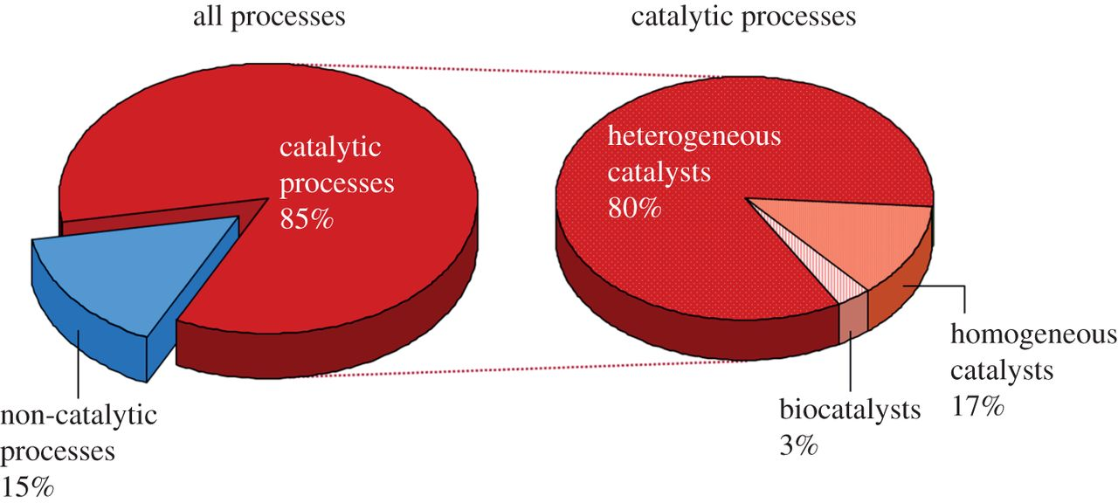
Homogeneous And Heterogeneous Catalysis
Most catalytic reactions in industry use heterogeneous catalysis
Homogeneous catalysts:
Advantages generally far more selective for a single product
far more active
far more easily studied from chemical & mechanistic aspects
far more easily modified for optimizing selectivity
Disadvantages far more sensitive to permanent deactivation
far more difficult for achieving product/catalyst separations

Slide 22
Terminologies in Catalysis
Turnover (TO) -- One loop through the catalyst cycle. Typically one equivalent of reactant is converted to one equivalent of product (per equivalent of catalyst).
Turnover Frequency (TOF) or Turnover Rate -- The number of passes through the catalytic cycle per unit time (typically sec, min or hrs). This number is usually determined by taking the # of moles of product produced, dividing that by the # of moles of catalyst used in the reaction, then dividing that by the time to produce the given amount of product.
Example: If 1 mole of catalyst converts 1000 moles of CO→CO₂ in 10 seconds then TOF = (1000/(1*10 s) = 100 s⁻¹
Turnover Number (TON) -- The absolute number of passes through the catalytic cycle before the catalyst becomes deactivated. A large TON (e.g., 10⁶ - 10¹⁰) indicates a stable, very long-lived catalyst. TON is defined as the amount of reactant (moles) divided by the amount of catalyst (moles) times the % yield of product.
Example: If 1 mole of catalyst converts 1000 moles of CO→CO₂ (100% yield) then TON = 1000

Slide 23
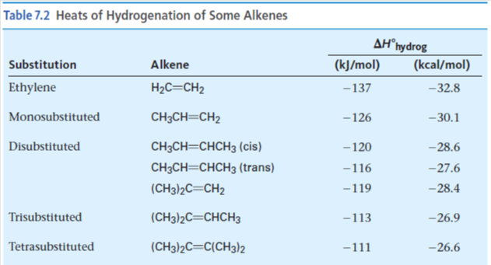
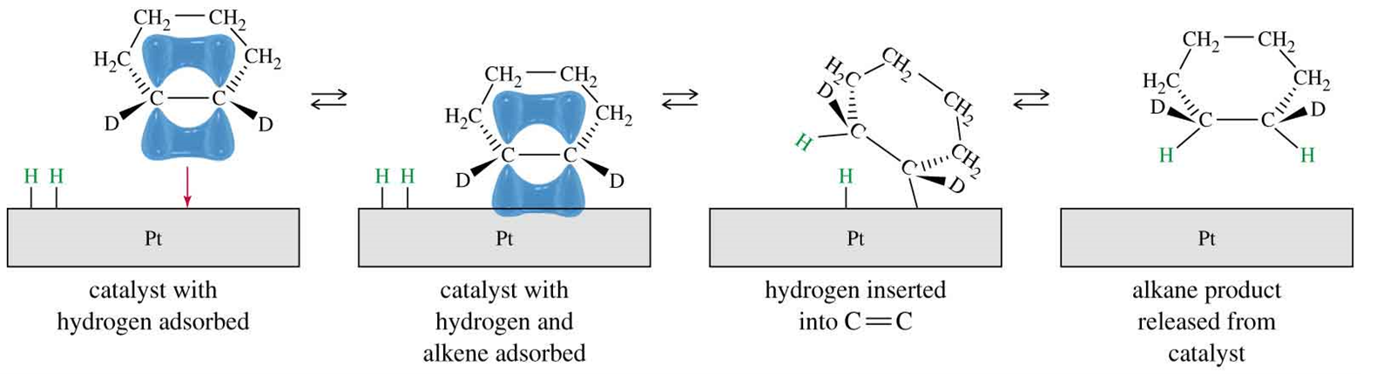
Important Catalytic Reactions: Alkene Hydrogenation
Alkene + H₂ → Alkane
Catalyst required, usually Pt, Pd, or Ni.
Finely divided metal, heterogeneous
Syn addition

Slide 24
Mechanism of catalytic hydrogenation.
H
H
B
Y
H
H
C
C
A
X
Notes:
8

Slide 25
Mechanism of catalytic hydrogenation.
B
Y
C
C
A
X
H
H
H
H
Notes:
9

Slide 26
Mechanism of catalytic hydrogenation.
B
Y
A
X
H
H
H
C
C
H
Notes:
9

Slide 27
Mechanism of catalytic hydrogenation.
B
Y
A
X
H
H
H
C
C
H
Notes:
9

Slide 28
Mechanism of catalytic hydrogenation.
B
Y
A
X
H
H
C
C
H
H
Notes:
9

Slide 29
Mechanism of catalytic hydrogenation.
B
Y
A
X
C
C
H
H
H
H
Notes:
9

